Slide 1
Project overview:-
Build a business dashboard that helps stakeholders to make decisions
Displays meaningful KPIs (sales, profit, etc.)
KPI used:-
Total Sales
Total Profit
Sales by Region
Sales by Category/Sub-Category
Profit Margin
Monthly Sales Trend

Slide 2
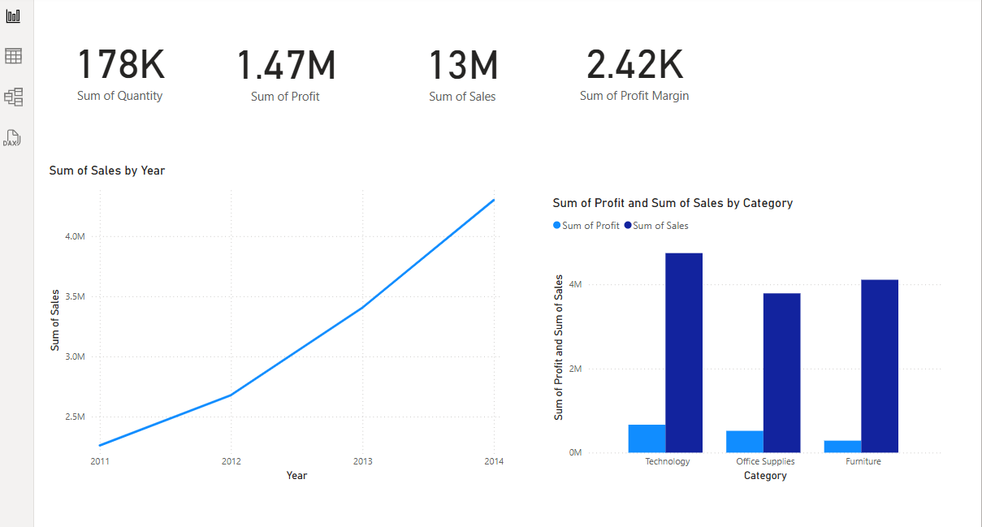
Screen shots of dashboard

Slide 3
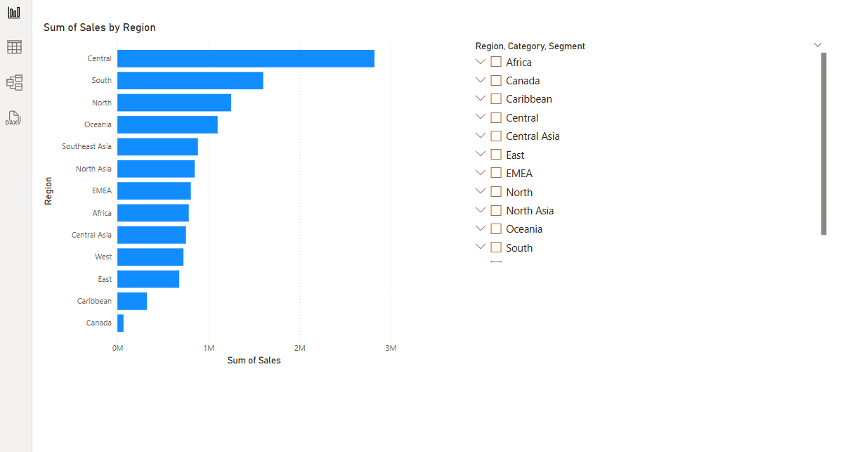

Slide 4
Conclusion:-
In Task 4, we designed an interactive business dashboard using the Superstore dataset to provide valuable insights for stakeholders. The dashboard includes key performance indicators such as Total Sales, Profit, Profit Margin, Sales by Region, Category Performance, and Time-based Sales Trends.
By integrating interactive slicers (Region, Category, Order Date), users can dynamically filter and explore data, enabling more informed and data-driven decisions. This dashboard effectively supports business monitoring and strategic planning by presenting data in a clear, insightful, and accessible format.

